Slide 1
Measuring Transaction Performance MongoDB Meets TPC-C
Asya Kamsky, MongoDB Maven
@asya999 #askAsya

Slide 2
Measuring Transaction Performance MongoDB Meets TPC-C
Asya Kamsky, MongoDB Maven
@asya999 #askAsya
Or how I learned to stop worrying and love the benchmarks.
Notes:
two talks in one: benchmarking and migrating from relational to document schema

Slide 3
Motivation
Or why I never liked benchmarking

Slide 4
Benchmarks
SQL
Badly executed
Don't apply to me/you
Notes:
BUT ...

Slide 5
Benchmarks
"Won't someone think about the customer!!!
Notes:
it's hard to be a customer – your boss wants "published benchmarks" so occasionally we succumb. 3.0/2014 history of "independent 3rd party"

Slide 6
Benchmarks
Notes:
our motivations: evergreen, regressions, get a general idea how "GOOD" our transactions are.

Slide 7
Methodology
Notes:
We had to pick a workload/benchmark... WANTED SOMETHING STANDARD!

Slide 8
State of NoSQL Standard Benchmarks
Notes:
We had to pick a workload/benchmark...

Slide 9
State of NoSQL Standard Benchmarks
Notes:
We had to pick a workload/benchmark...

Slide 10
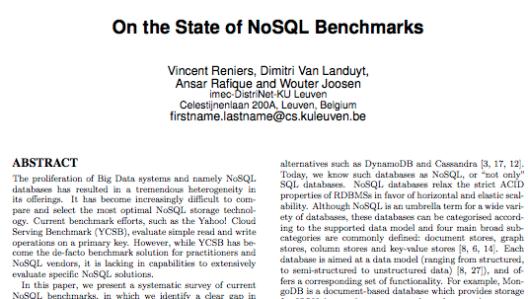
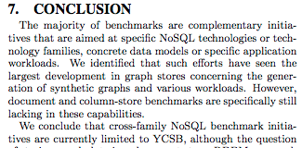
State of NoSQL Standard Benchmarks
Notes:
noSQLParticularly lacking in DOCUMENT DATABASES! : LIMITED TO YCSB.

Slide 11
TPC-C
What the heck is it?

Slide 12
TPC-C
Notes:
Transaction Processing Performance Council
1988

Slide 13
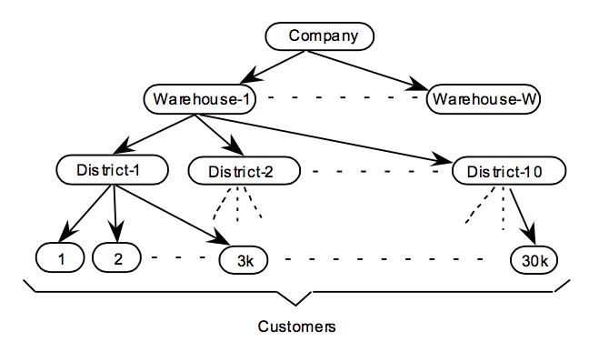
TPC-C
Data Model:
Workload:
Transactions:
New Order
Delivery
Payment
Order Status Check
Stock Level Check

Slide 14
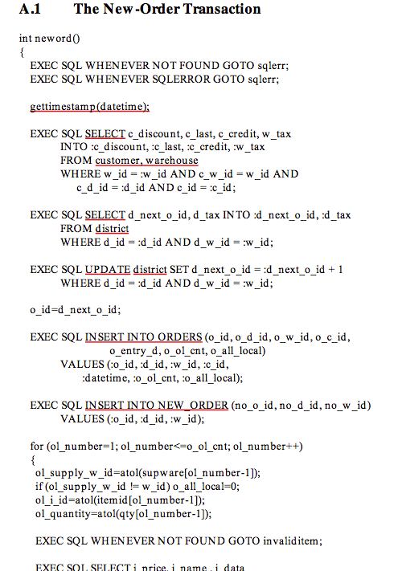
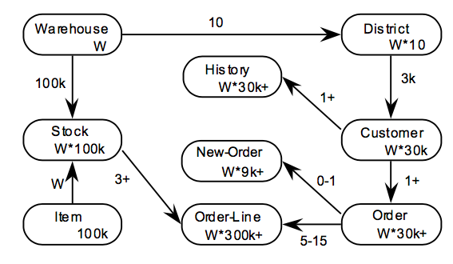
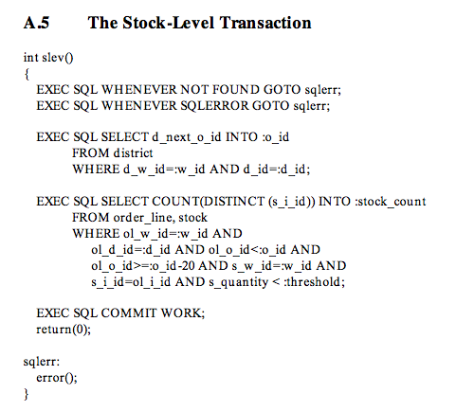
TPC-C
Data Schema:
Workload:
Transactions:
New Order
Delivery
Payment
Order Status Check
Stock Level Check
Notes:
HAD MODEL AND WORKLOAD (but not CODE)

Slide 15
TPC-C
CODE?
Data Model.
Workload.
Measure="TpmC"
Notes:
NEW ORDERS PER MINUTE
CODE!!! I hate writing code. But I love changing other people's code. Also I hate Java, I sort of hate C/C++ and I love Python.

Slide 16
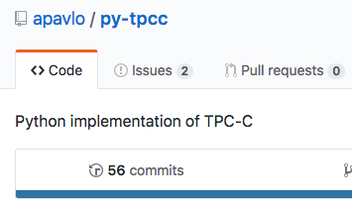
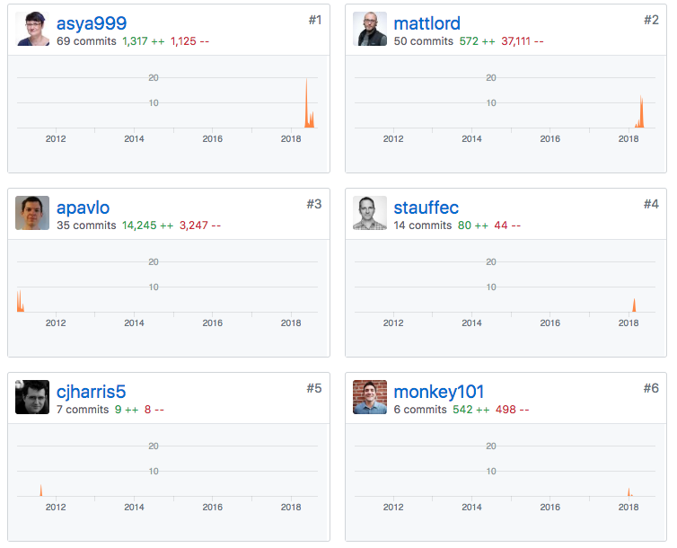
PY-TPCC
Notes:
CODE!!! I hate writing code. But I love changing other people's code. Also I hate Java, I sort of hate C/C++ and I love Python.

Slide 17
Evolution of TPC-C for MongoDB

Slide 18
Evolution of TPC-C for MongoDB
Wrap every “transaction” in 'transaction'

Slide 19
# before
def doPayment(self, params):
w_id = params["w_id"]
d_id = params["d_id"]
Notes:
NOTE: CHECK IF SESSION IS PASSED TO noTransaction

Slide 20
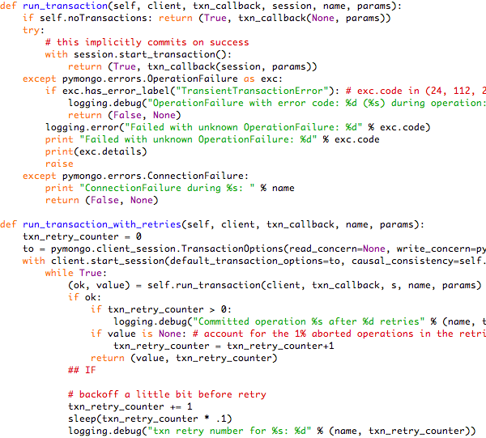
# before
def doPayment(self, params):
w_id = params["w_id"]
d_id = params["d_id"]
# after
def doPayment(self, params):
(value, retries) =
self.run_transaction_with_retries(
self.client,
self._doPaymentTxn,
"PAYMENT", params)
return (value, retries)
def _doPaymentTxn(self, params):
w_id = params["w_id"]
d_id = params["d_id"]
Notes:
NOTE: CHECK IF SESSION IS PASSED TO noTransaction

Slide 21
# before
def doPayment(self, params):
w_id = params["w_id"]
d_id = params["d_id"]
# after
def doPayment(self, params):
(value, retries) =
self.run_transaction_with_retries(
self.client,
self._doPaymentTxn,
"PAYMENT", params)
return (value, retries)
def _doPaymentTxn(self, params):
w_id = params["w_id"]
d_id = params["d_id"]
Notes:
NOTE: CHECK IF SESSION IS PASSED TO noTransaction

Slide 22
Evolution of TPC-C for MongoDB
Add Standard MongoDB Options

Slide 23
TPC-C
Old:
host
port
dbname
normalized or not
New:
Full URI
Authentication support
Connect to replica set
Options for every A/B setting
Multiple Runtime Options
Notes:
NORMALIZED – same as relational

Slide 24
Evolution of TPC-C for MongoDB
Fix Data Model (i.e. schema)

Slide 25
TPC-C
Data Schema RDBMS:
Original py-tpcc
TWO MODES:
Normalized
Denormalized

Slide 26
TPC-C
Data Schema Old:
Original py-tpcc
TWO MODES:
Normalized
Denormalized
Notes:
NORMALIZED – same as relational

Slide 27
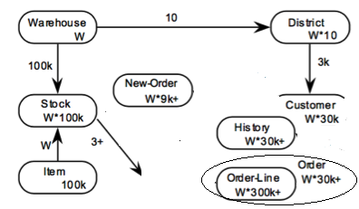
TPC-C
Data Schema Old:
Original py-tpcc
TWO MODES:
Normalized
Denormalized
Notes:
fixed denormalized schema to be more consistent with best practices: initial implementation provided a normalized option which mirrored the RDMBS schema exactly, and a "denormalized" option which embedded all customer related information (orders, order lines, history) into the customer document. This is an anti-pattern as the customer record will grow unbounded and performance will get worse and worse the longer the system is operational. Instead to be consistent with our schema design recommendations, order_lines were embedded into orders (as they are inherently part of the order and are limited in size) but the rest of the schema was left normalized with typical referencing to related entities by "foreign keys" same as in RDBMS. We noted database sizes at the end of the load and each run as well as throughput and latencies.

Slide 28
TPC-C
Data Schema New:
Modes:
Normalized
Denormalized (new)
OrderLines[]
Notes:
This would be a good time to note that denormalized schema was *smaller* than normalized, due to every order line not repeating the same information that's in the parent order record. We mention this because conventional wizdom about "denormalization" is that it takes up more space, not less.

Slide 29
TPC-C
Data Schema New:
Modes:
Normalized
Denormalized (new)
OrderLines[]
Notes:
As you'll see in performance summaries, embedding array of order lines into orders provided one of significant performance improvements, along with optimizing indexes.

Slide 30
TPC-C
Data Schema New:
Modes:
Normalized
Denormalized (new)
OrderLines[]

Slide 31
TPC-C
Data Schema New:
Normalized
Denormalized (new)
OrderLines[]
Notes:
Denormalizing the schema has obvious performance win since the number of round trips to the database is now reduced - you can think of it as pre-joining order lines into the orders table. While TPC-C explicitly prohibits such schema alterations, this sort of schema design pattern is the core advantage of using a document database like MongoDB, and it wouldn't be in line with our best practices to use a different approach to schema design

Slide 32
Evolution of TPC-C for MongoDB
FIX INDEXES
Notes:
next – most obvious performance fix (after schema)

Slide 33
TPC-C
Old:
Suboptimal
New:
Optimal indexes

Slide 34
TPC-C
Old:
Suboptimal
ITEM: "I_ID"
WAREHOUSE: "W_ID"
DISTRICT: "D_ID"
"D_W_ID"
CUSTOMER: "C_ID"
"C_D_ID"
"C_W_ID"
STOCK: "S_W_ID"
"S_I_ID"
ORDERS: "O_ID"
"O_D_ID"
"O_W_ID"
"O_C_ID"
NEW_ORDER: "NO_O_ID"
"NO_D_ID"
"NO_W_ID"
New:
Optimal indexes
ITEM: "I_ID"
WAREHOUSE: "W_ID","W_TAX"
DISTRICT: "D_W_ID","D_ID","D_NEXT_O_ID","D_TAX"
CUSTOMER: "C_W_ID", "C_D_ID", "C_ID"
"C_W_ID","C_D_ID","C_LAST"
STOCK: "S_W_ID","S_I_ID","S_QUANTITY"
"S_I_ID"
ORDERS: "O_W_ID", "O_D_ID","O_ID","O_C_ID"
"O_W_ID","O_D_ID","O_C_ID","O_ID","O_CARRIER_ID"
NEW_ORDER: "NO_W_ID","NO_D_ID","NO_O_ID"
Notes:
simplistic approach

Slide 35
TPC-C
Old:
Suboptimal
ITEM: "I_ID"
WAREHOUSE: "W_ID"
DISTRICT: "D_ID"
"D_W_ID"
CUSTOMER: "C_ID"
"C_D_ID"
"C_W_ID"
STOCK: "S_W_ID"
"S_I_ID"
ORDERS: "O_ID"
"O_D_ID"
"O_W_ID"
"O_C_ID"
NEW_ORDER: "NO_O_ID"
"NO_D_ID"
"NO_W_ID"
New:
Optimal indexes
ITEM: "I_ID"
WAREHOUSE: "W_ID","W_TAX"
DISTRICT: "D_W_ID","D_ID","D_NEXT_O_ID","D_TAX"
CUSTOMER: "C_W_ID", "C_D_ID", "C_ID"
"C_W_ID","C_D_ID","C_LAST"
STOCK: "S_W_ID","S_I_ID","S_QUANTITY"
"S_I_ID"
ORDERS: "O_W_ID", "O_D_ID","O_ID","O_C_ID"
"O_W_ID","O_D_ID","O_C_ID","O_ID","O_CARRIER_ID"
NEW_ORDER: "NO_W_ID","NO_D_ID","NO_O_ID"
Notes:
simplistic approach

Slide 36
HARDWARE SELECTION
Notes:
it was time to select actual hardware

Slide 37
EASY: Atlas, MongoDB DaaS
Replica Set (3 nodes)
GCE
M80 (also M50 & M60)
us-east1 (3 AZ)
Client:
GCE
n1-highcpu-16
No HW/OS configuration decisions
4.0.latest
Automatically updated/patched/etc
Monitoring!
Notes:
We went with GCE due to slightly lower cost for comparable hardware and picked M80 cluster which gave us 120 GBRAM and 750 GB stor- age. These instances have 32 vCPUs which would allow us to test scaling the number of connections up without overwhelming the server. Standard MongoDB replica set deployment is three nodes, one of which acts as the primary, the other two being secondaries and replicating all writes from the primary. By default all reads are directed to the primary unless the client indicates a di erent read preference [7]. For our client we selected GCE n1-highcpu-16 instance in the same region “us-east1” to reduce latency between client and the database.

Slide 38
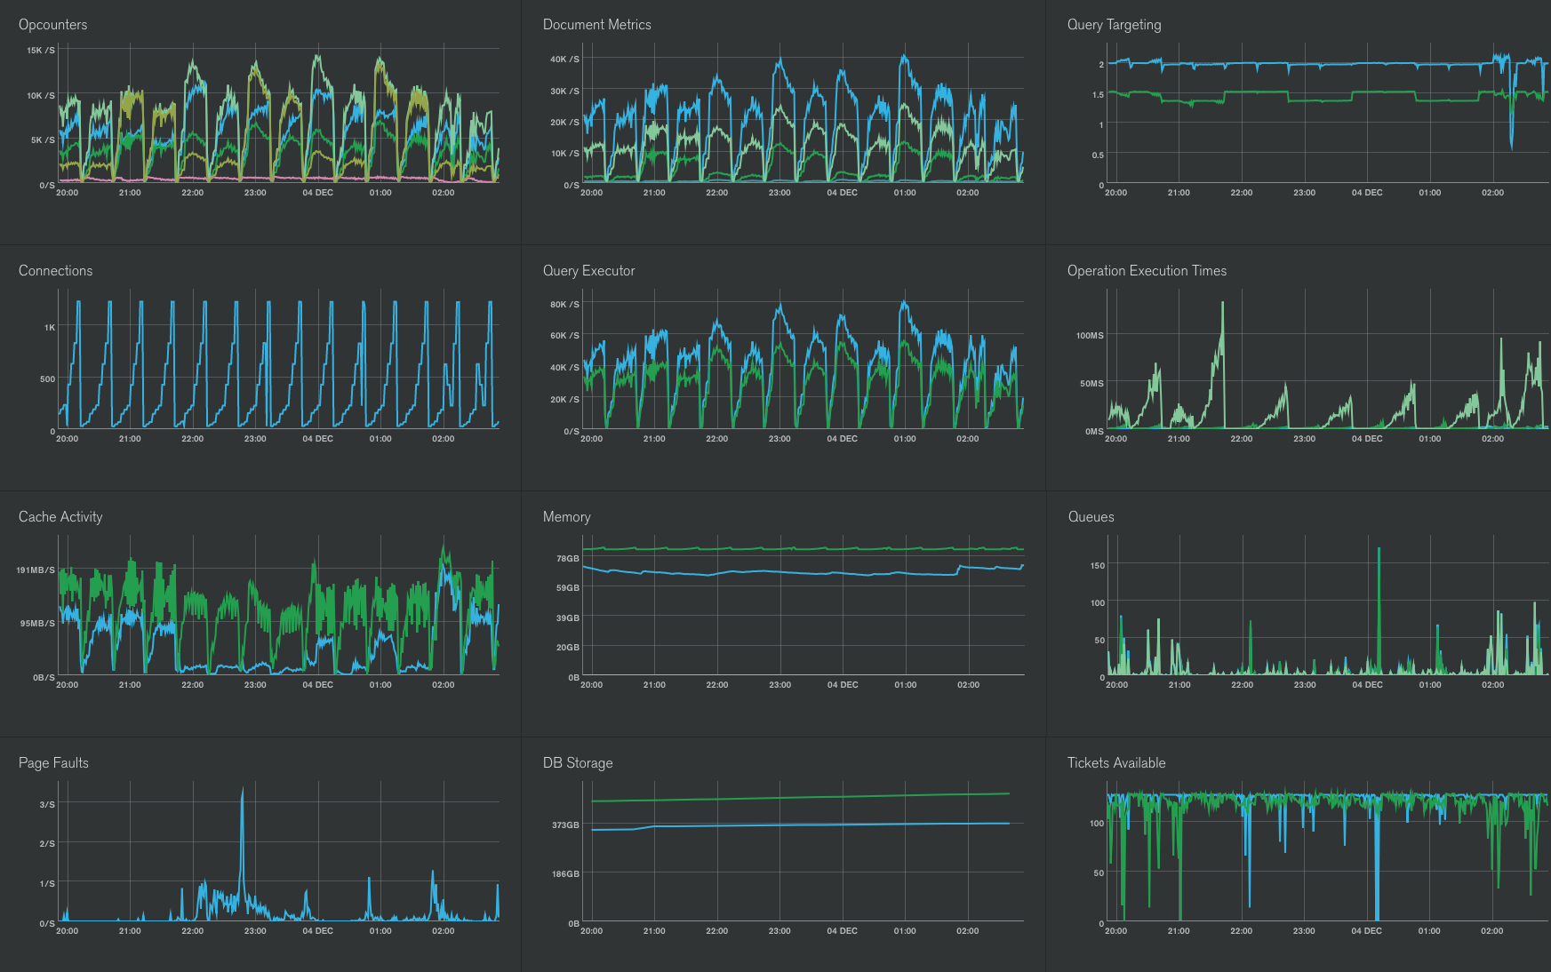
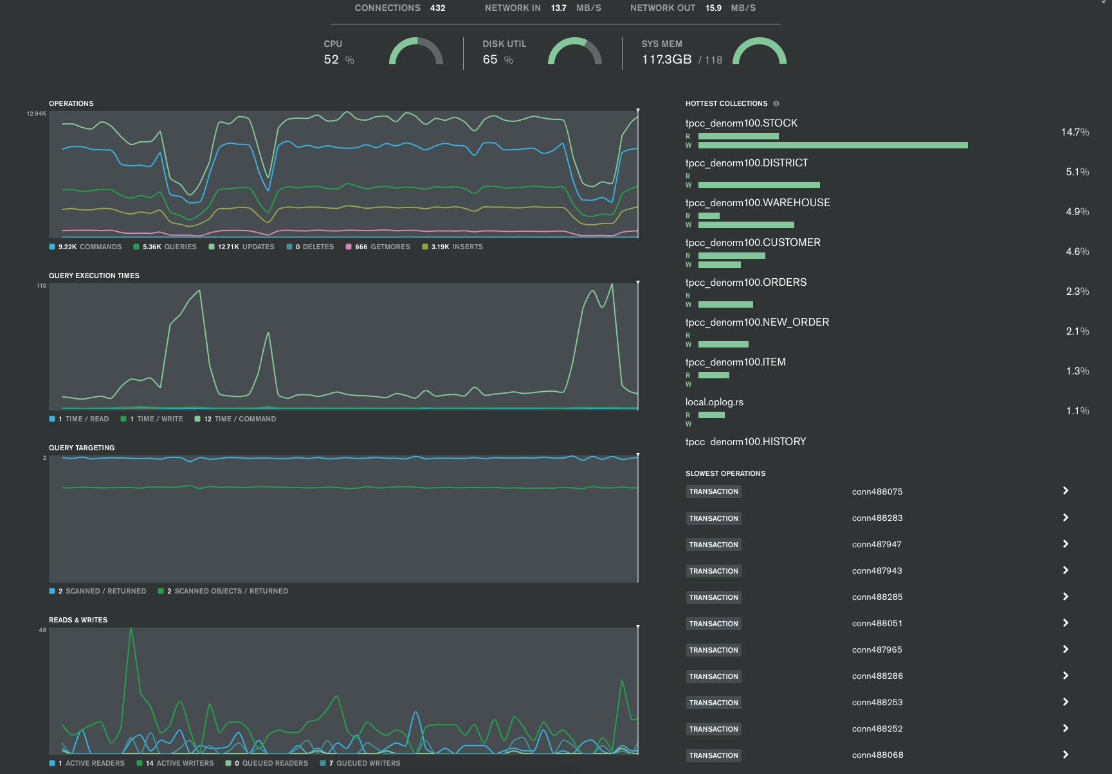
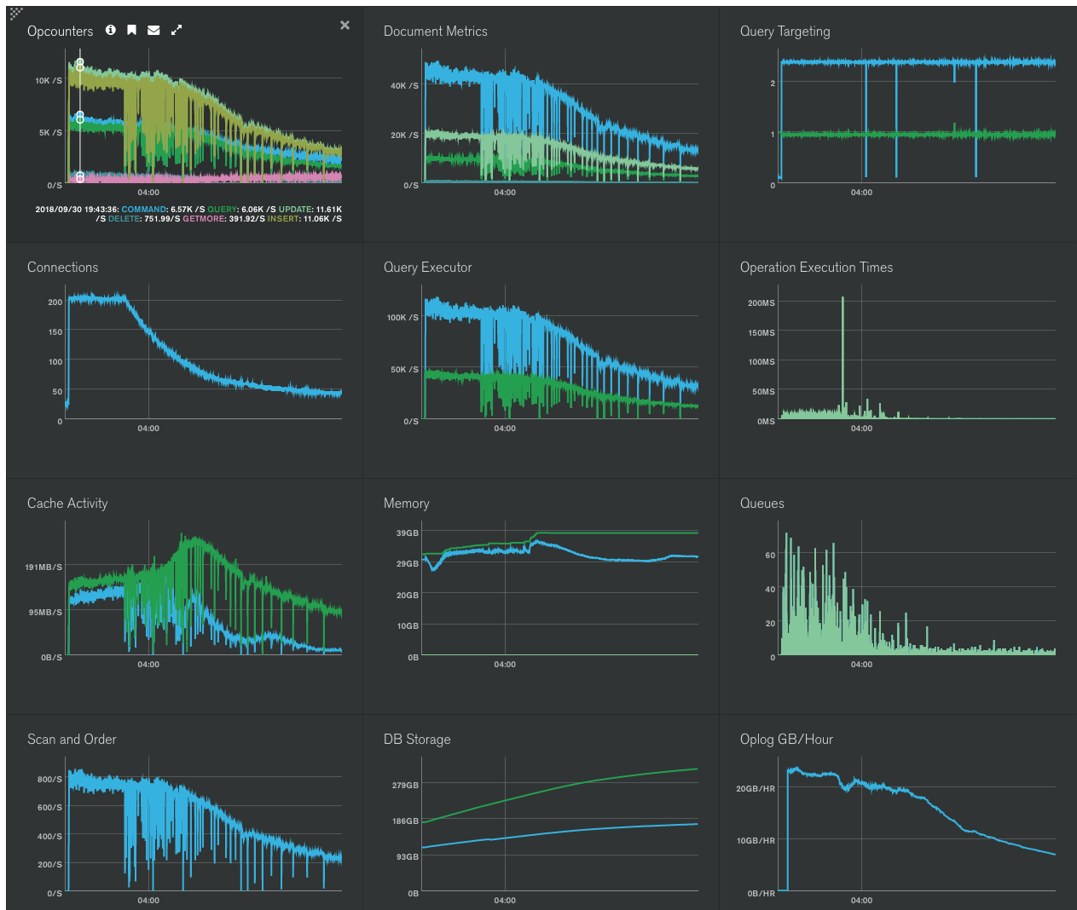
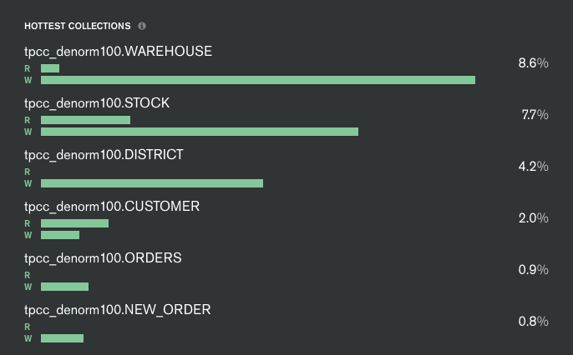
EASY: Atlas, MongoDB DaaS

Slide 39
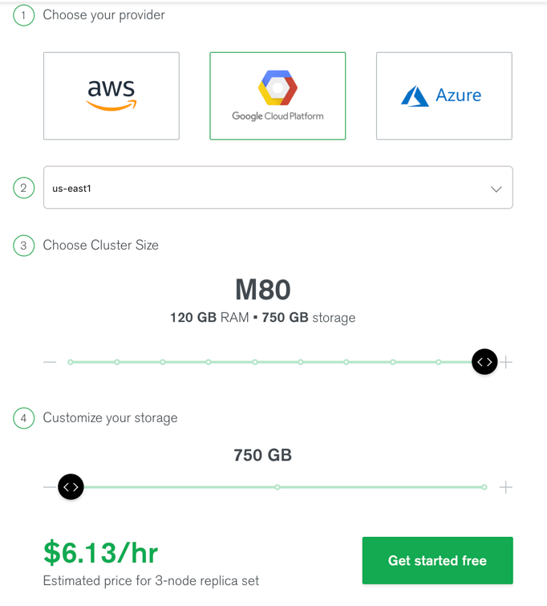
TPC-C Cost Per "T" in TpmC

Slide 40
Evolution of TPC-C for MongoDB
Code Optimization
Notes:
- Fixed a bunch of basic inefficiencies – unneccesary operations, redundant work
- Looked for causes for re-tries with transactions: fail early to minimize useless work
- Looked at each individual operation to understand where there may be better access options
- Order of table access when mixing reads and writes (warehouse first as most likely candidate for contention)
- Profile queries and updates for number of index entries and documents accessed

Slide 41
Evolution of TPC-C for MongoDB
findAndModify instead of update_one + find_one

Slide 42
TPC-C
Old:
o = self.orders.find_one(
{"O_ID": o_id,
"O_D_ID": d_id,
"O_W_ID": w_id,
"$comment": c}, session=s)
self.orders.update_one(
{"_id": o['_id'], "$comment": c},
{"$set": {
"O_CARRIER_ID": o_carrier_id,
"ORDER_LINE.$[].OL_DELIVERY_D":
ol_delivery_d}},
session=s)
New:
o= self.orders.find_one_and_update(
{"O_ID": o_id,
"O_D_ID": d_id,
"O_W_ID": w_id,
"$comment": c},
{"$set": {
"O_CARRIER_ID": o_carrier_id,
"ORDER_LINE.$[].OL_DELIVERY_D":
ol_delivery_d}}, session=s)

Slide 43
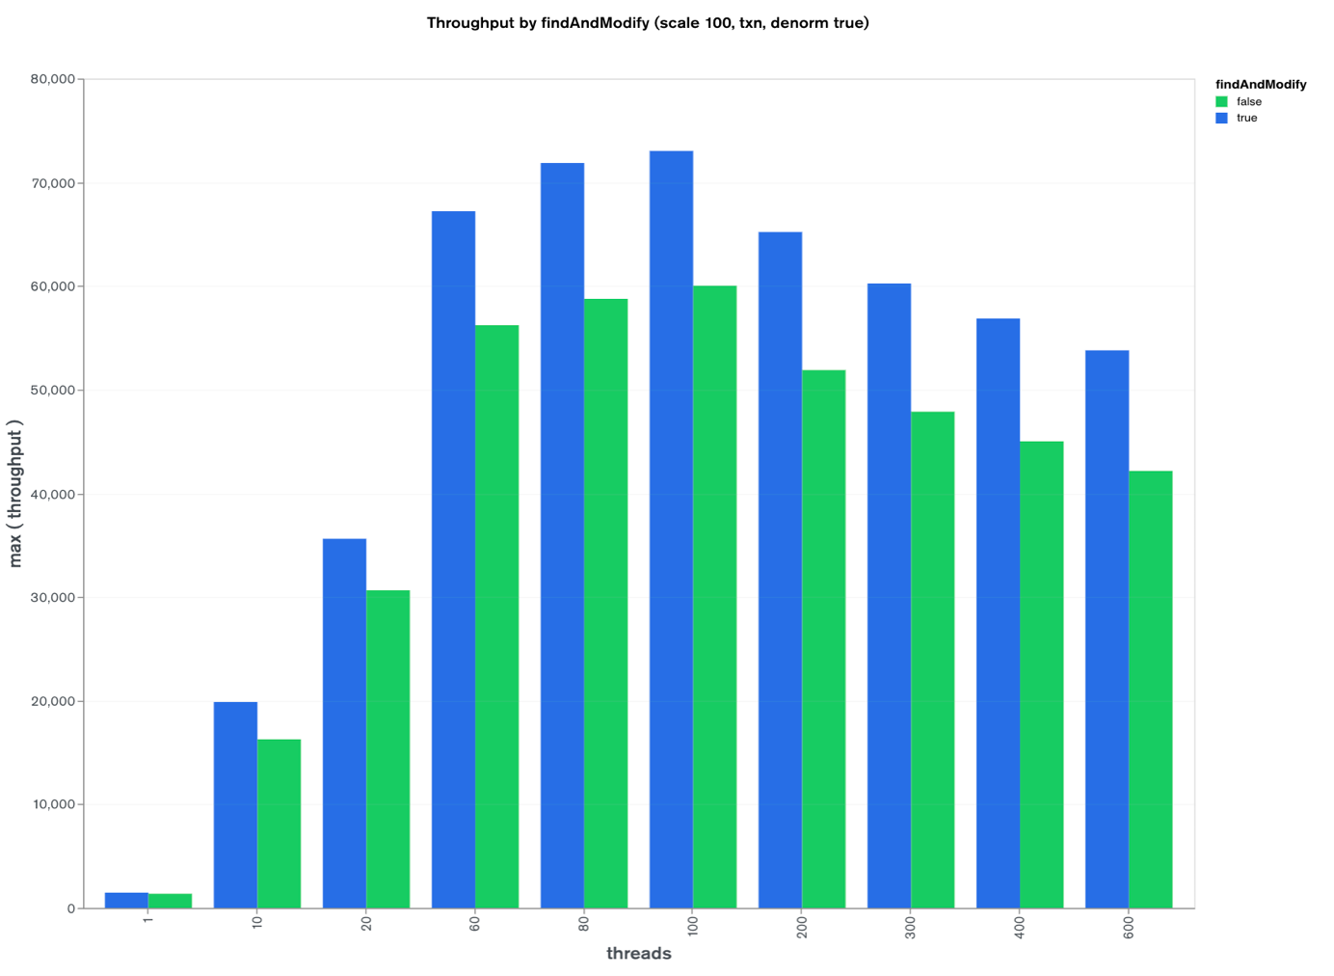
TPC-C
New:

Slide 44
Evolution of TPC-C for MongoDB
Secondary Reads

Slide 45
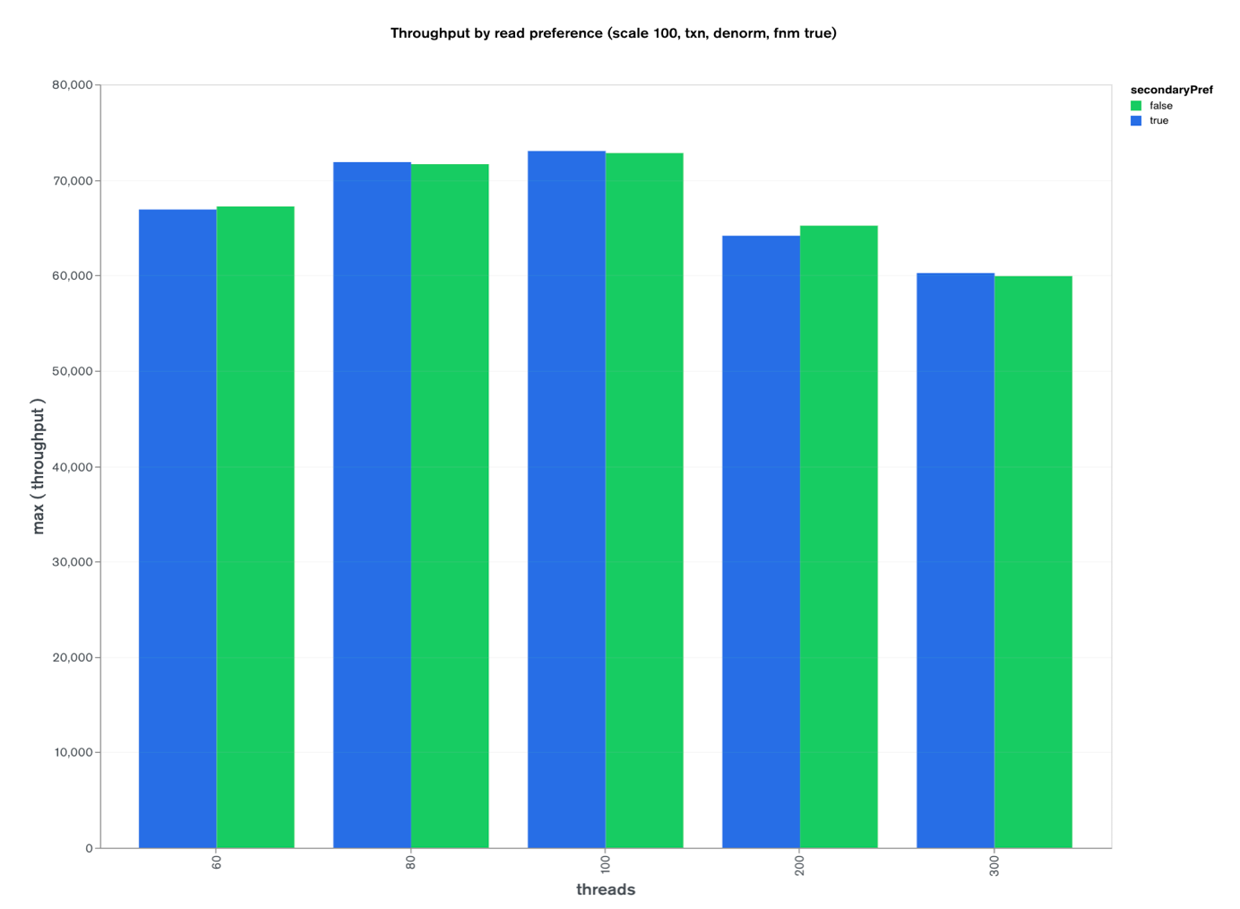
TPC-C

Slide 46
Evolution of TPC-C for MongoDB
WriteConcern

Slide 47
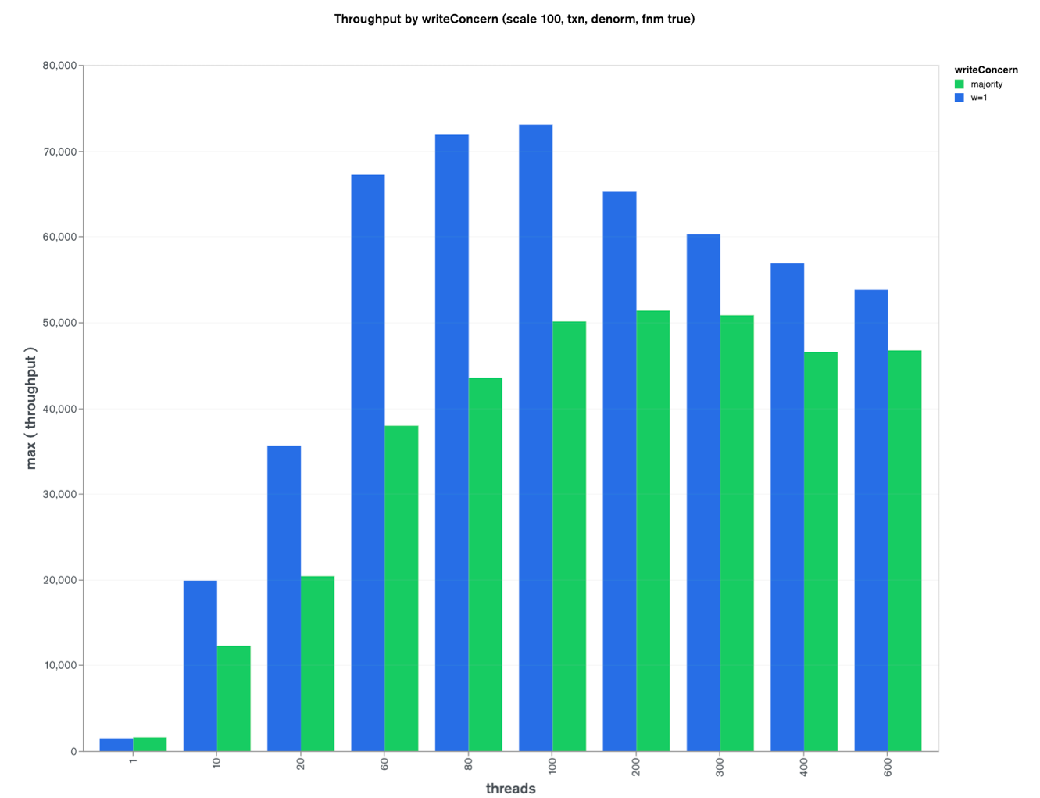
TPC-C

Slide 48
Evolution of TPC-C for MongoDB
Batch Writes

Slide 49
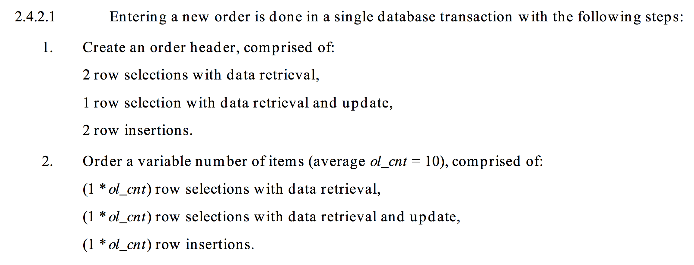
TPC-C
Old NEW_ORDER:
New NEW_ORDER:

Slide 50
TPC-C
Old NEW_ORDER:
for i in range(ol_cnt):
self.stock.update_one(si,
{"$set": {"S_QUANTITY": ...},
session=s)
self.order_line.insert_one(
ol, session=s)
New NEW_ORDER:
stockWrites = []
orderLineWrites = []
for i in range(ol_cnt):
stockWrites.append(
pymongo.UpdateOne(si,
{"$set": {"S_QUANTITY": ...}}))
orderLineWrites.append(ol)
self.order_line.insert_many(
orderLineWrites, session=s)
self.stock.bulk_write(
stockWrites, session=s)
Notes:
NO CHART BUT MUCH FASTER(!)

Slide 51
Evolution of TPC-C for MongoDB
Batching Deliveries
Notes:
The Delivery business transaction consists of processing a batch of 10 new (not yet delivered) orders.

Slide 52
TPC-C
Notes:
Each order is processed (delivered) in full within the scope of a read-write database transaction.
The number of orders delivered as a group (or batched) within the same database transaction is implementation specific.

Slide 53
TPC-C
Old Delivery :
Pick Warehouse:
start Transaction
for each of ten deliveries
do delivery
done
commit Transaction
done
New Delivery:
Pick Warehouse:
for each of ten deliveries
start Transaction
do delivery
commit Transaction
done
done
Notes:
The number of orders delivered as a group (or batched) within the same database transaction is implementation specific.

Slide 54
TPC-C
Measure and analyze everything*
* even the stuff you think you know
Notes:
HOW DID WE DO?
Very interesting, initially it seemed like we did much better with ten-transactions for ten-deliveries...
But then I went "oh no, I don't have a chart to show how MUCH better we did!"
And it turned out we don't do better – we actually do a little worse, or in the case of w=majority we do quite a bit worse!!!
Benchmark the actual final production code even if you benchmarked it "before"!

Slide 55
Analyzing Results
Easy! MongoDB Charts!

Slide 56
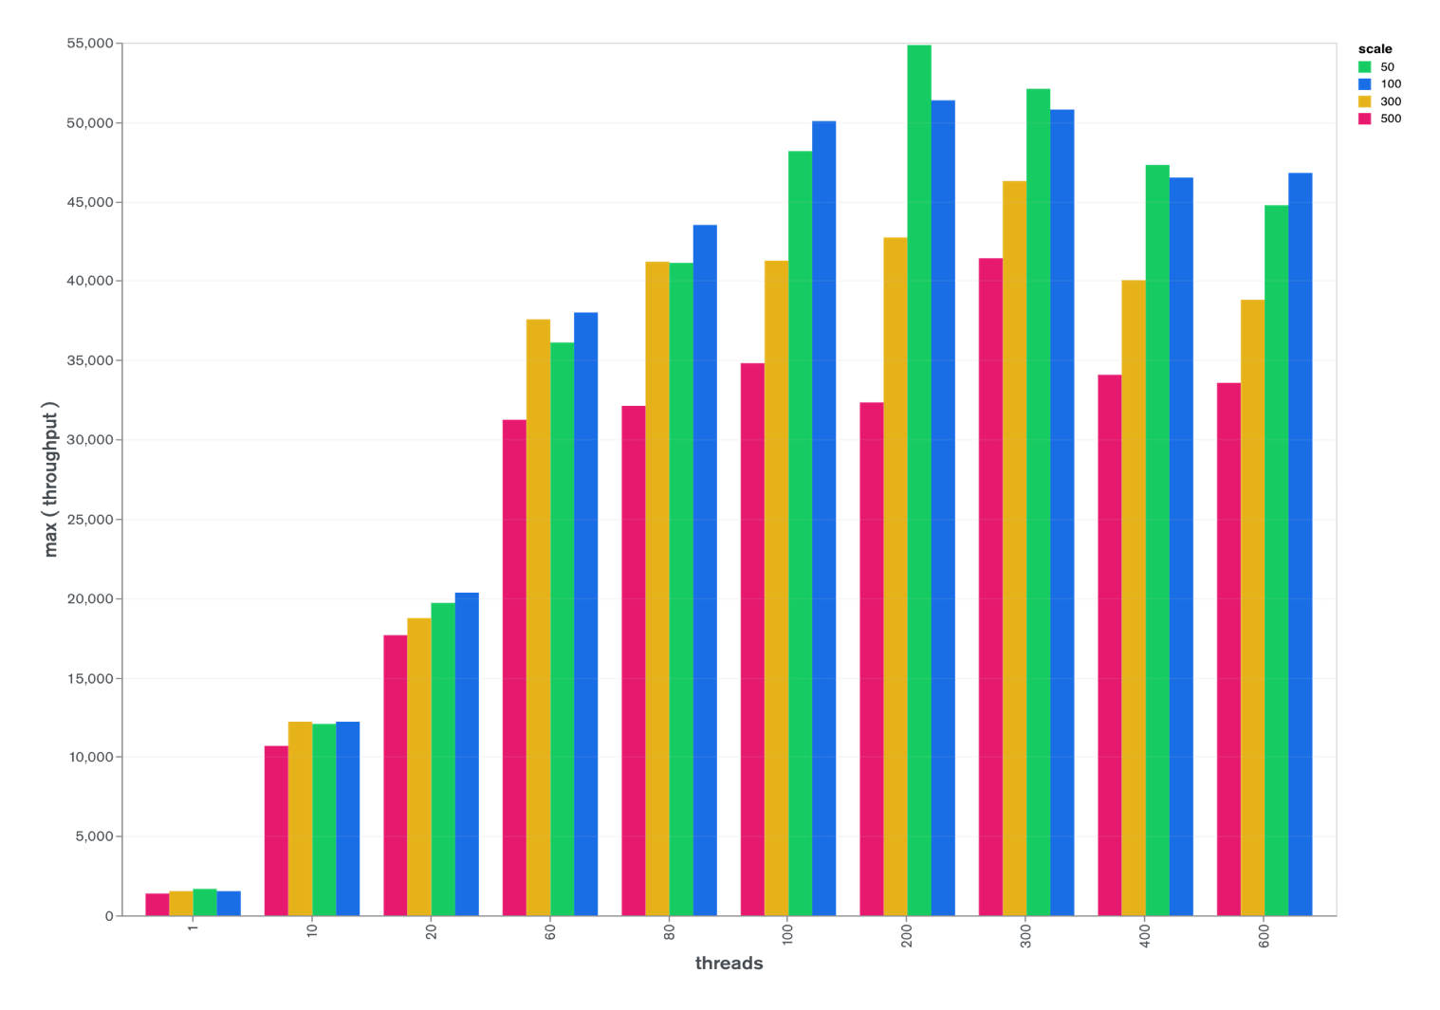
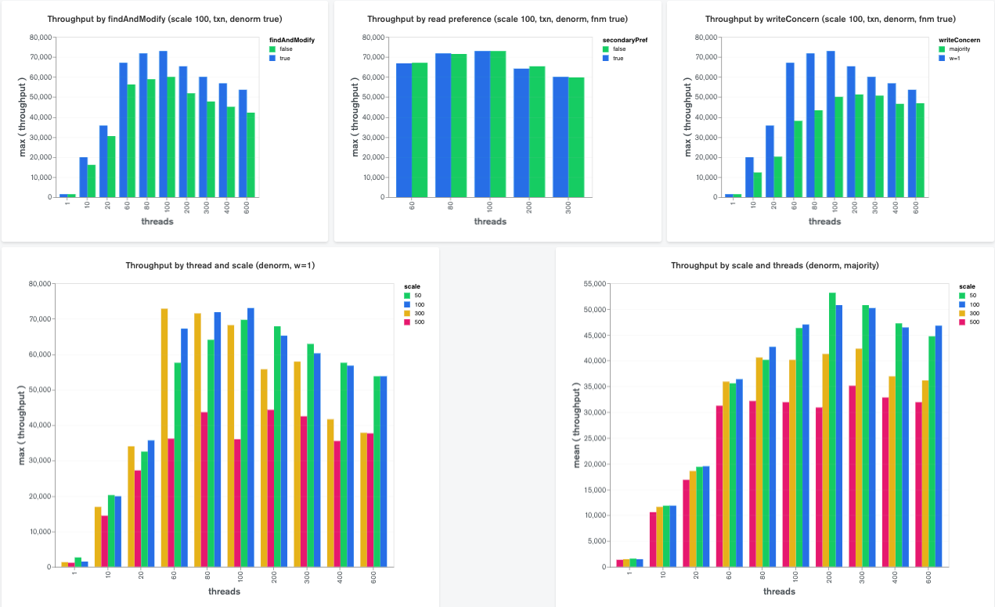
Results:
Notes:
LIVE DEMO

Slide 57
Throughput (Y) vs Scale (X) by Instance Type:
M50
M60
M80
Notes:
LIVE DEMO

Slide 58
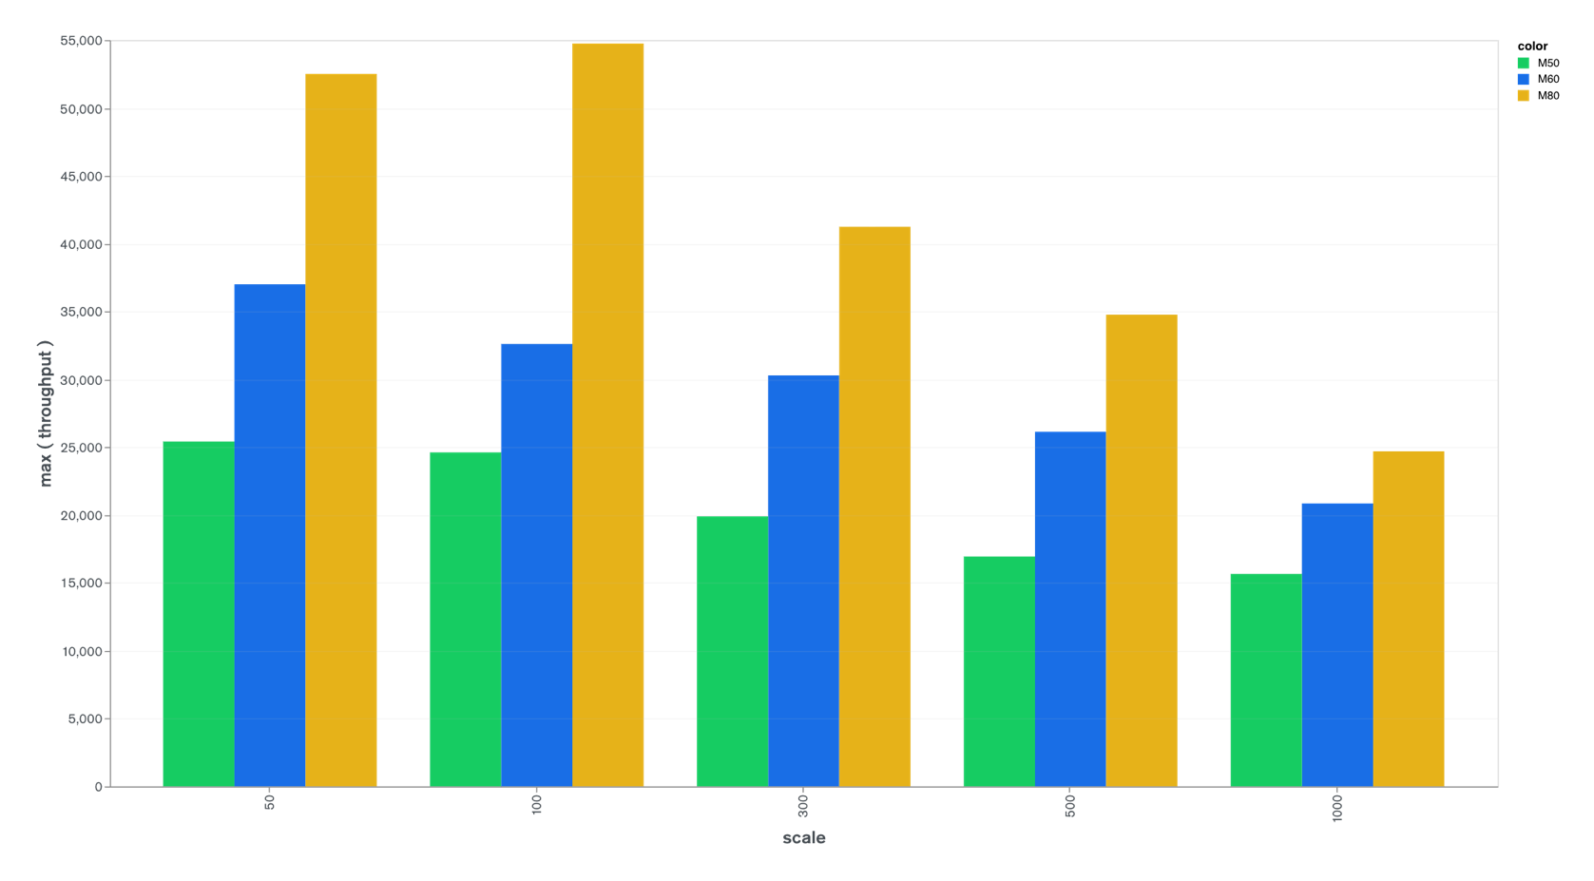
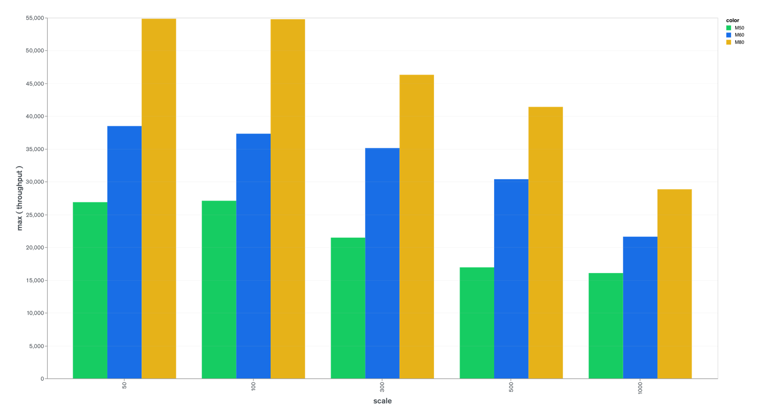
Throughput (Y) vs Scale (X) by Instance Type:
55,000 -
M50
M60
M80
50,000 -
45,000 -
40,000 -
35,000 -
30,000 -
25,000 -
20,000 -
15,000 -
WC: majority
threads:100
p50: 31-190ms
10,000 -
WC: majority
threads:100-600
p50: 37-775ms
5,000 -
0 -
50
100
300
500
1000
Notes:
LIVE DEMO

Slide 59
TPC-C Cost Per "T" in TpmC

Slide 60
Throughput (Y) vs Scale (X) by Instance Type:
55,000 -
M50
M60
M80
50,000 -
45,000 -
40,000 -
35,000 -
30,000 -
25,000 -
20,000 -
15,000 -
10,000 -
WC: majority
threads:100
p50: 31-190ms
5,000 -
0 -
50
100
300
500
1000
Notes:
LIVE DEMO

Slide 61
What's next?
Publish paper

Slide 62
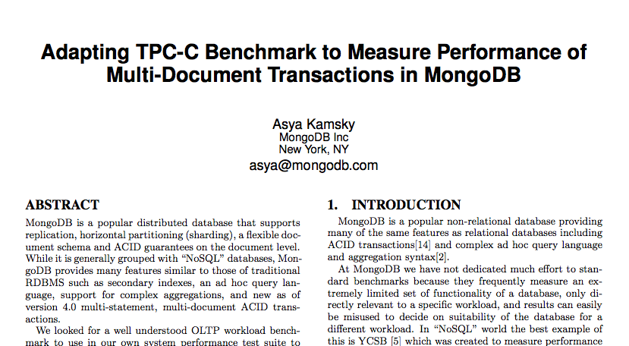
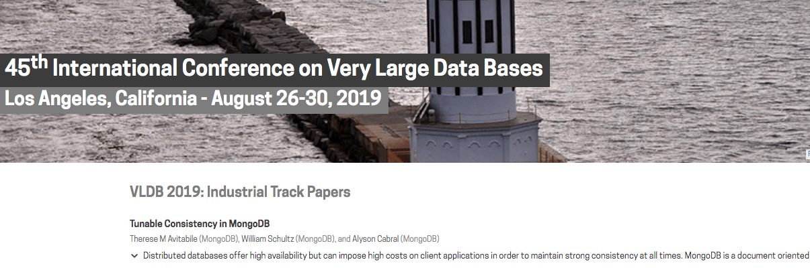
What's next?
Publish paper VLDB 2019

Slide 63
What's next?
Publish paper VLDB 2019
Make github repo public
Submit more changes upstream
Extend for sharded workload
Measure bigger scale
Adapt more traditional benchmarks?

Slide 65
Thank you! Question?
Asya Kamsky
MongoDB Principal KnowItAll

